Slide 1
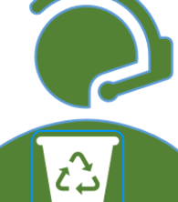
Recycling Helper
Complete Recycling Guide

Slide 2






Find Information about Recycling Label using ARCore app
ARCore Mobile App
Find Recycling Center
What is recycling Label?
What is recycling Label?
User
Detail about Label Part
How to Recycle

Slide 3
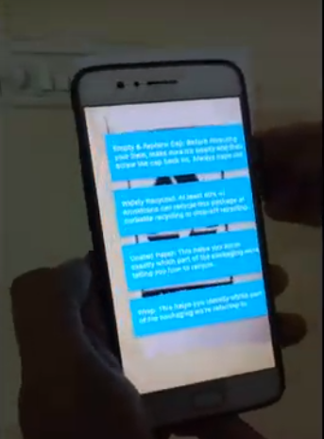
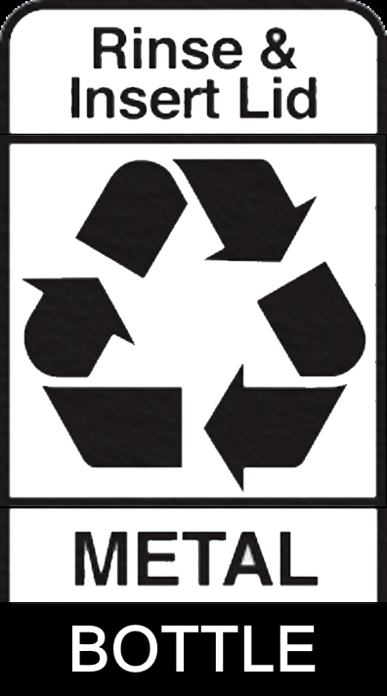
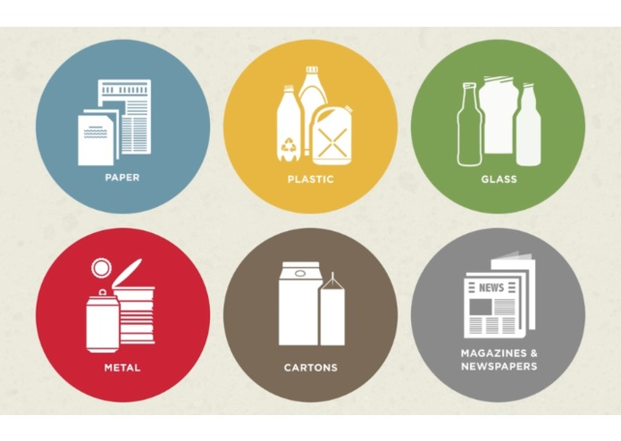
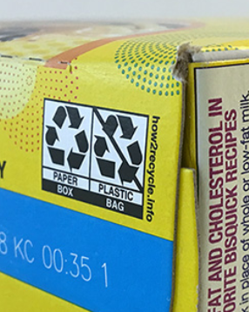
Find Information about Recycling Label using ARCore app
Label Data
Displayed on App
Scan Label
Recycling Helper App based on Sumerian and ARCore
Recycling Label
on Items
User

Slide 4
Find Recycling Center
What is recycling Label?
What is recycling Label?
User
Detail about Label Part
ARCore Mobile App
How to Recycle

